Slide 1

IoT Platform
A Case Study

Slide 2
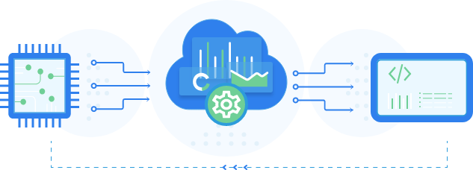
Kaa Cloud
Hardware Integrations
Device Management
Data Collection
Configuration Management
Integrations
Command Executions
Connectivity

Slide 3
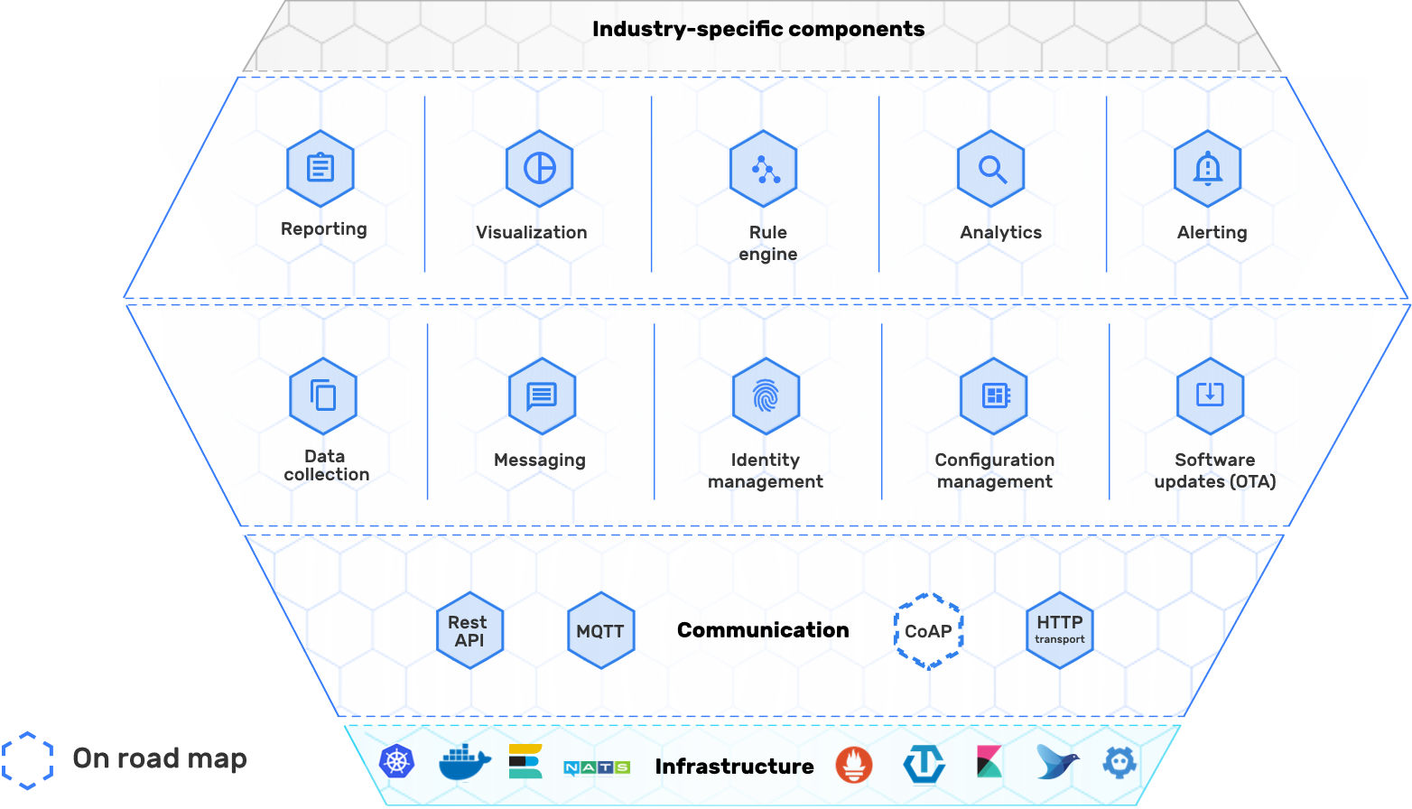
Architecture Overview

Slide 4
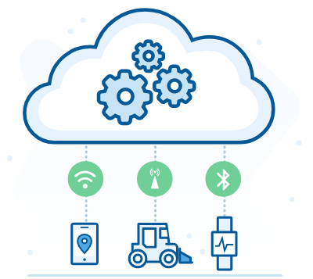
Connectivity
It is about messaging between the cloud and connected devices.
It supports popular lightweight IoT protocols for device connection, such as MQTT and HTTP
It employs a gateway architecture

Slide 5
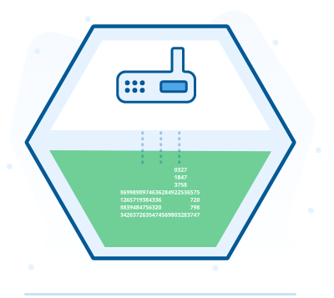
Device Management
Keep record of device digital twins (aka “endpoints” in Kaa terminology).
Manage access credentials that devices use to connect to Kaa.
Manage endpoint metadata attributes.
Group devices by filtering against their metadata attributes.
To connect, a device has to present valid credentials, such as pre-shared keys, tokens, login and password combinations, certificates, etc

Slide 6
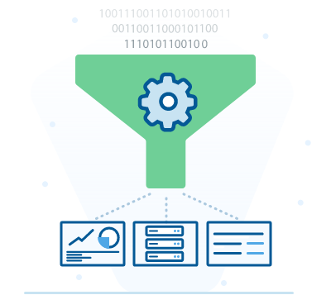
Data Collection
To minimize network usage and improve the data throughput, the protocol supports batching. It provides your devices with the capability to buffer data locally before uploading it in one message
It allows you to collect both structured and unstructured data

Slide 7
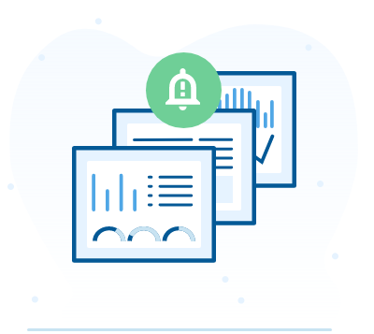
Alerts, Triggers and Notifications
It allows you to customize your data charts, filter and query data, and quickly set up alerts based on your analytics
A basic rule engine functionality for your IoT projects
Configure and use various communication channels, such as email, Slack, SMS, push notifications

Slide 8
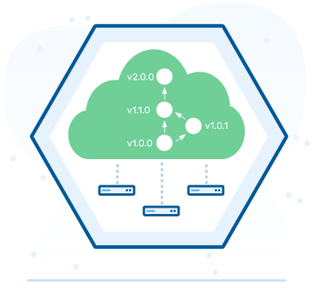
Over The Air Updates!
It reliably deliver software updates by utilizing the confirmation response codes sent by devices upon the update result
It defines the software update path by using the compatibility graphs based on semantic versioning
It allows tracking the current software version installed on the managed devices as well as defining potential update vectors

Slide 9
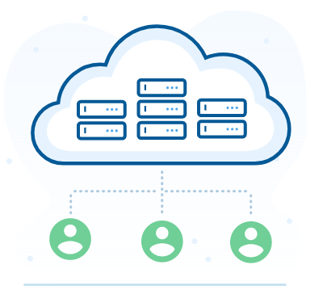
Multitenancy
Single Kaa instance may serve multiple independent tenants and each tenant’s data is completely isolated from other tenants
Tenants can manage their own users, user permissions, applications, devices, dashboards

Slide 10
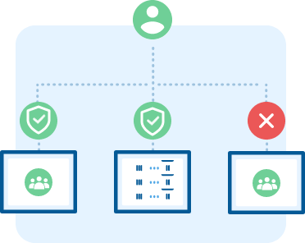
Identity and Access Management (IAM)
The data any solution accumulates needs to be protected from bad-faith actors and from unauthorized access
Assign access policy in minutes, configure group membership, and implement new security policy enforcement via our intuitive UI

Slide 11
Kaa Concepts
Endpoints
ID
Meta data
Token
Application
Versions
Solutions
Services
Extensions

Slide 12
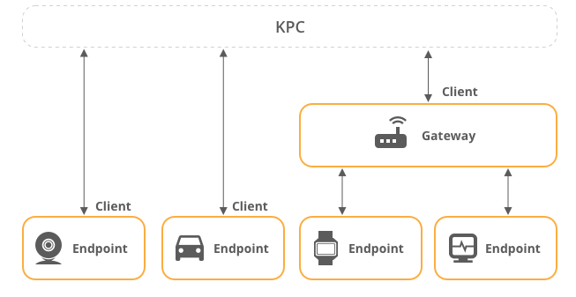
Endpoints
An endpoint is any terminal device that you want to manage with the Kaa platform. An endpoint can either be a physical device or a software emulation thereof
ID are used to identify the particular endpoint
Tokens are any non-empty strings that do not contain the following reserved characters: +, #, /, an .
Metadata can be endpoint’s location, description, serial number, hardware version, etc.

Slide 13
Solutions
It is a logical namespace in the Kaa Web Dashboard that embraces a certain use case, e.g. fleet management
It consists of a set of visual components (dashboards, widgets, etc.) and operates with one or more Kaa applications.

Slide 14
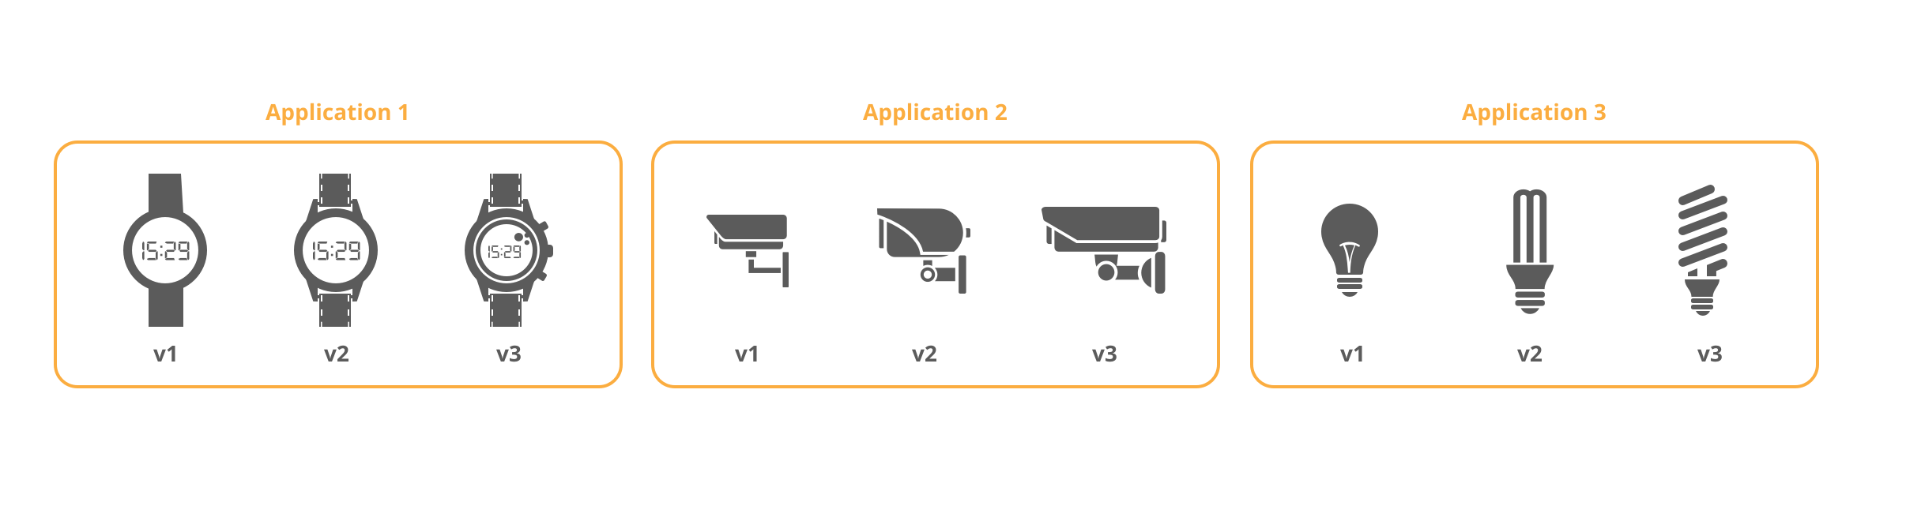
Applications
To handle different types of devices simultaneously and allow them to co-exist in the scope of a single solution
Use versions to evolve your devices by adding or retiring features while keeping your old versions up and running.

Slide 15
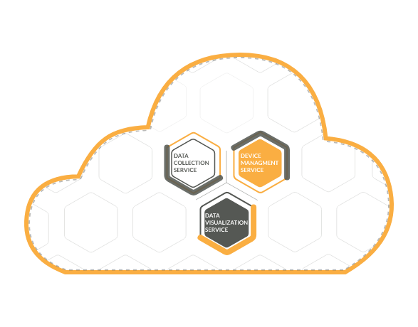
Services
Kaa is based on Microservice architecture
Docker based software application instances
All services are not required, you can choose the essentials services only

Slide 16
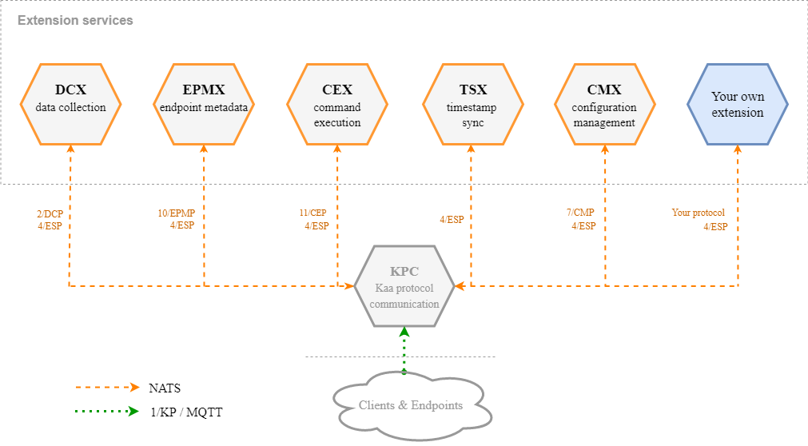
Extension Service

Slide 17
Kaa Protocol Communication Service
Plain MQTT
MQTT/TLS
MQTT/Websocket
and plain HTTP transport implementations

Slide 18
Client Credential Management Service
It serves the authentication of the clients via-
Client basic authentication by username/password combination
Client X.509 authentication using TLS certificates.

Slide 19
References
Kaa RFCs - https://github.com/kaaproject/kaa-rfcs/#kaa-rfcs

